Slide 1

Kolhapur Institute of Technology’s College of Engineering (Empowered Autonomous)
A Project Presentation on :- “Associative Memory Retriever: Scaling Long-Context QA with Modern Hopfield Networks.”
Presented By: Under Guidance of:
Tirth Katkar DS-25 Prof. Karishma Tamboli
Pratham Kadam DS-14
Niranjan Ambi DS-01
Shreya Gunjakar DS-61
1
Department of Computer Science and Engineering(AIML/DS)

Slide 2
Problem Statement
1. The "Lost in the Middle" Phenomenon
Traditional Transformers struggle with massive text contexts, often ignoring facts hidden in the middle of long documents due to self-attention limitations.
2. Brittle Retrieval in Standard RAG
Current Retrieval-Augmented Generation (RAG) relies on simple vector similarity (Cosine Similarity), which is often too rigid to handle complex or noisy natural language queries.
3. Inefficient Scaling of Context Windows
Expanding the context window in standard models increases computational costs quadratically, making long-form Question Answering (QA) expensive and slow.
.
2
Department of Computer Science and Engineering(AIML/DS)

Slide 3
Objectives
1. Implement Modern Hopfield Networks (MHNs)
Develop a continuous associative memory layer based on the state-of-the-art Ramsauer et al. (2020) framework.
2. Energy-Based Factual Retrieval
Move beyond "lookups" to "associative recall," where a query settles into a factual energy basin to retrieve the most coherent context.
3. Robustness to Query Noise
Ensure the system can "repair" imperfect or partial user queries using the stored pattern completion capabilities of Hopfield layers.
4. Scalable Memory Architecture
Create a retriever that can handle massive text corpora (like SQuAD or LongBench) with exponential storage capacity.
3
Department of Computer Science and Engineering(AIML/DS)

Slide 4
Literature Review
Hopfield Networks is All You Need |  | LITERATURE REVIEW
AUTHORS | METHODOLOGY | Findings: Proved that Modern Hopfield Networks have exponential storage capacity and are mathematically equivalent to the Transformer attention mechanism, providing a bridge between associative memory and deep learning.
Hubert Ramsauer, et al. | Methodology: Redefined the energy function of Hopfield Networks using the Log-Sum-Exp rule.
4
Department of Computer Science and Engineering(AIML/DS)

Slide 5
Literature Review
Dense Associative Memory for Pattern Recognition |  | LITERATURE REVIEW
AUTHORS | METHODOLOGY | Findings: Demonstrated that increasing the nonlinearity of the energy function allows the network to store and retrieve a much higher number of patterns (power-law or exponential) compared to the linear capacity of classic models
Dmitry Krotov, John J. Hopfield | Proposed an alternative to traditional Hopfield networks using power-law interaction functions..
5
Department of Computer Science and Engineering(AIML/DS)

Slide 6
Literature Review
Modern Hopfield Networks and Attention for Long-Context QA |  | LITERATURE REVIEW
AUTHORS | METHODOLOGY | Confirmed that energy-based retrieval is significantly more robust against "noise" in queries and effectively solves the "lost-in-the-middle" problem in massive text documents
Bernhard Schafl, et al. | Evaluated the use of Modern Hopfield Layers as a replacement for standard RAG-based lookup systems.
6
Department of Computer Science and Engineering(AIML/DS)

Slide 7
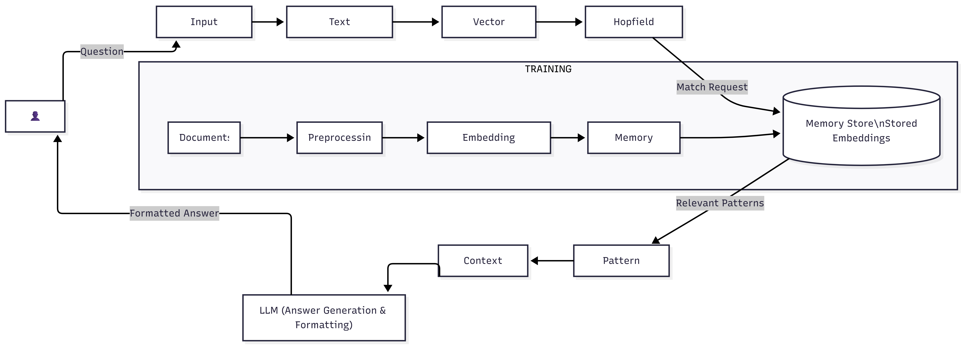
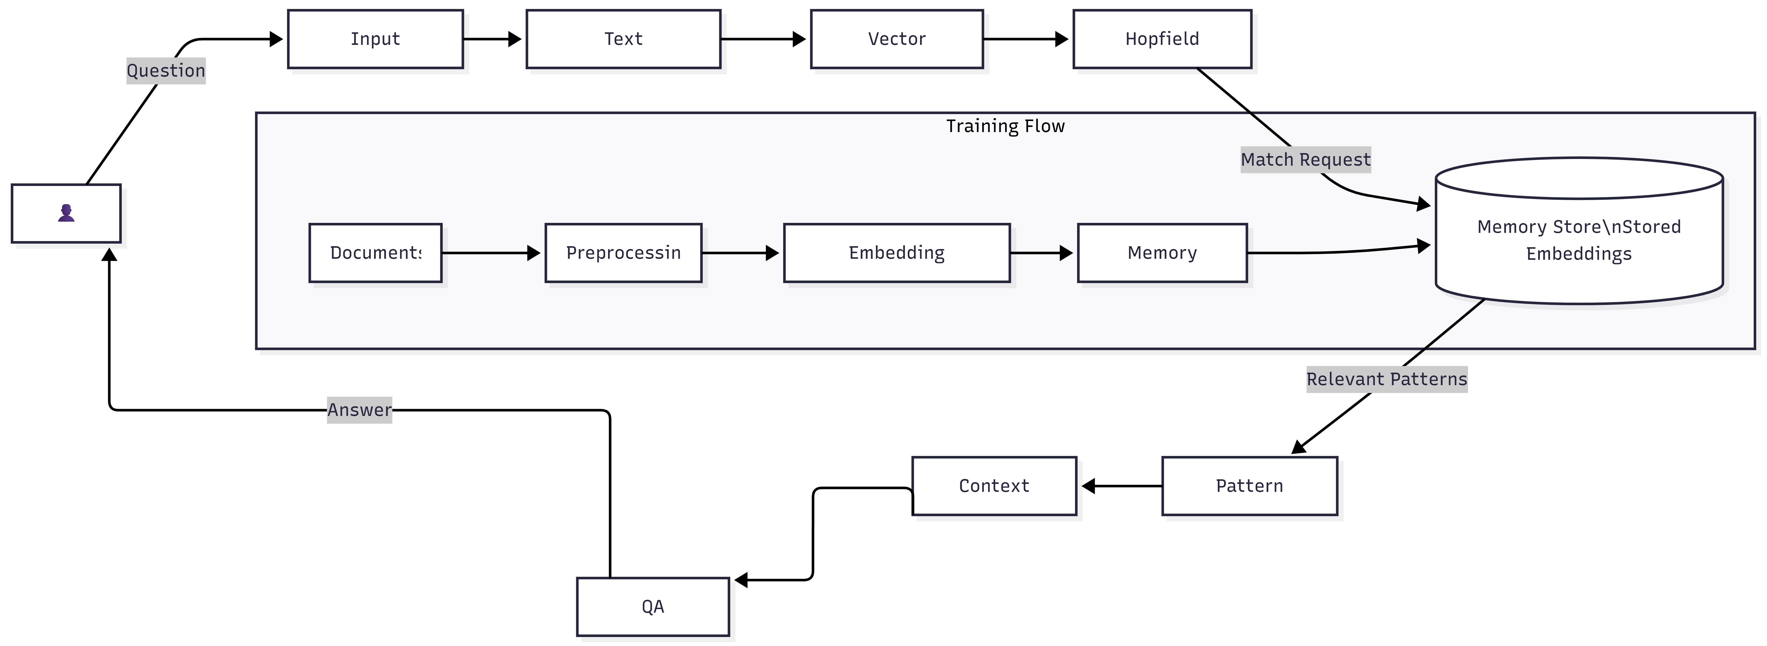
Data Flow Diagram
7
Department of Computer Science and Engineering(AIML/DS)

Slide 8
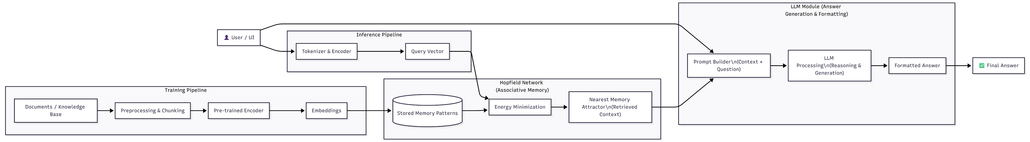
System Architecture
8
Department of Computer Science and Engineering(AIML/DS)

Slide 9
Technologies Used
Frontend & Monitoring Technologies
Streamlit: Enables the rapid creation of an interactive web dashboard for users to input questions and visualize the model's output.
FastAPI: Acts as a high-performance bridge to expose your AI logic as an API, allowing other applications to communicate with your model.
LangSmith / Langfuse: Provides a dedicated "magnifying glass" to track LLM reasoning steps, monitor costs, and debug incorrect answers.
CLI (Command Line Interface): Offers a lightweight environment for developers to test code logic and run scripts without a graphical interface.
9
Department of Computer Science and Engineering(AIML/DS)

Slide 10
Technologies Used
Backend Technologies
Python: The core programming language for system logic and AI integration.
PyTorch: The engine for executing deep learning and Hopfield layer computations.
Hopfield-Layers: Uses associative memory to retrieve precise context from documents.
Hugging Face: Provides pre-trained models to convert text into numerical vectors.
LLM (Llama/GPT): The reasoning engine that generates natural, human-like answers.
LangChain/LlamaIndex: Orchestrates the data flow between retrieval and generation.
FAISS/ChromaDB: High-speed databases for storing and searching document embeddings.
10
Department of Computer Science and Engineering(AIML/DS)

Slide 11
Existing Technologies Survey
Technology | Purpose | Key Limitation
FAISS (Facebook AI) | High-speed similarity search library. | Brittle: Purely mathematical (K-Nearest Neighbor) with no contextual "reasoning".
Pinecone / Milvus | Enterprise-managed vector storage. | Expensive & Rigid: Requires massive memory and re-indexing every time data changes.
Standard RAG | Retrieval-Augmented Generation. | Hallucinations: Often retrieves semantically similar but factually irrelevant text.
11
Department of Computer Science and Engineering(AIML/DS)

Slide 12
Future Work
1. Real-Time Online Learning
Enabling the Hopfield landscape to update "on-the-fly" as new information is ingested without retraining the entire model.
2. Browser-Based Research Assistant
Evolving the system into a browser extension for real-time verification and context retrieval from live web pages.
3. GraphRAG Integration: Combine Hopfield memory with Knowledge Graphs to handle complex, multi-hop reasoning.
4. Semantic Caching: Store previous query results in associative memory to reduce LLM costs and provide instant responses.
12
Department of Computer Science and Engineering(AIML/DS)

Slide 13
Conclusion
This project successfully bridges the gap between traditional Information Retrieval and modern Generative AI by utilizing Modern Hopfield Networks as a high-precision associative memory. By integrating this specialized retrieval layer with the reasoning power of an LLM, the system moves beyond simple keyword matching to a sophisticated RAG (Retrieval-Augmented Generation) architecture. This approach ensures that the model provides contextually accurate, human-like answers while significantly reducing hallucinations. Ultimately, this project demonstrates how advanced neural memory structures can optimize long-context processing, making AI interactions more reliable, scalable, and grounded in factual data.
13
Department of Computer Science and Engineering(AIML/DS)

